Slide 1
Car Recommendation Expert System
WID2001
Knowledge Representation and Reasoning

Slide 2
Members
CHENG BOON RONG WID160011
MOHAMAD DANIEL BIN MOHAMAD ROSLAN WID160016
MOHAMAD FAKHRUL RAZI BIN OSMAN WID160017
IZATUL SYAFIQAH BINTI ZAINAL WID160013
ALI MAJEDI WID160704

Slide 3
Introduction
Frame
represent stereotypical knowledge about a particular object or concept
object, attribute and value
generic and inherited
combine both declarative and procedural knowledge
can be developed using object-oriented programming languages such as Java

Slide 4
Aim and Objectives
To apply the knowledge of frame that we learned in class to make the system
To apply the concept of frame in a real object
To represent the object and its attributes in a user friendly manner

Slide 5
Problem Statement
eases the process in representing the information
attributes and values of a certain class can be inherited to the instances
save time and much easier compared to store the same information from the main class or superclass every time a new class is created

Slide 6
Scope
focus on two brands of Malaysia cars, Proton and Perodua
search engine might showing results that less relevant and not precise.
analysis on brand that user prefer, type of car and user’s budget

Slide 7
DESIGN
(frame and rules sets)

Slide 8
Class : Car
Brand Proton Perodua
Car Type Sedan Hatchback MPV
Name Saga Perdana Persona Prevé Suprima S Iriz Exora Ertiga Bezza Alza Axia Myvi
Price RM24000 - RM68110
SuperClass

Slide 9
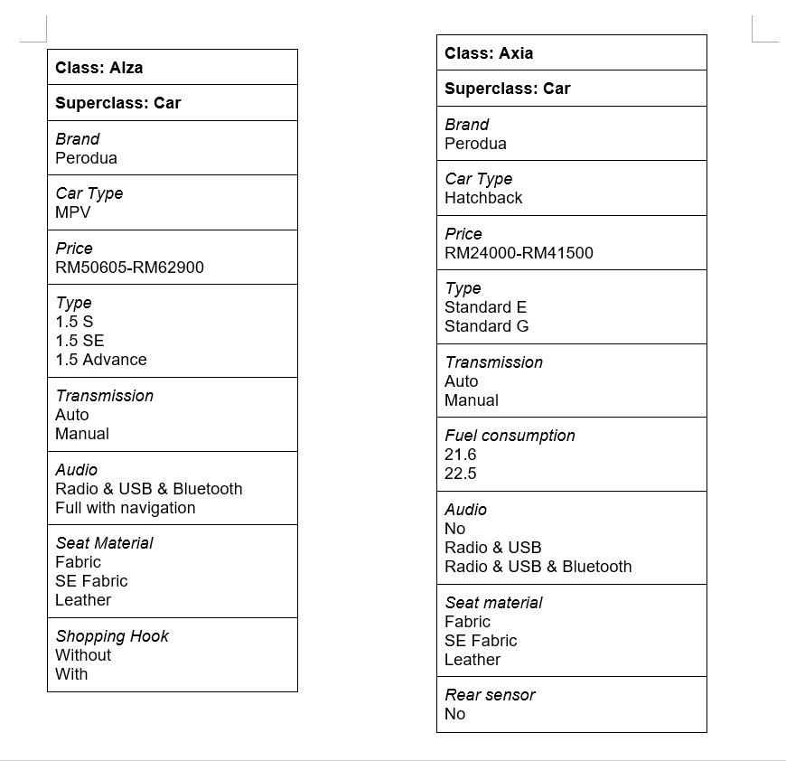
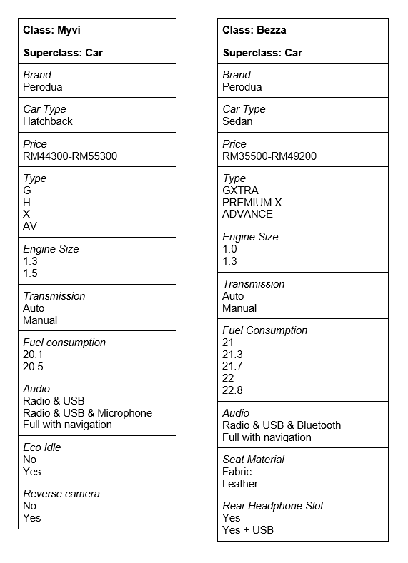
Subclassess

Slide 10
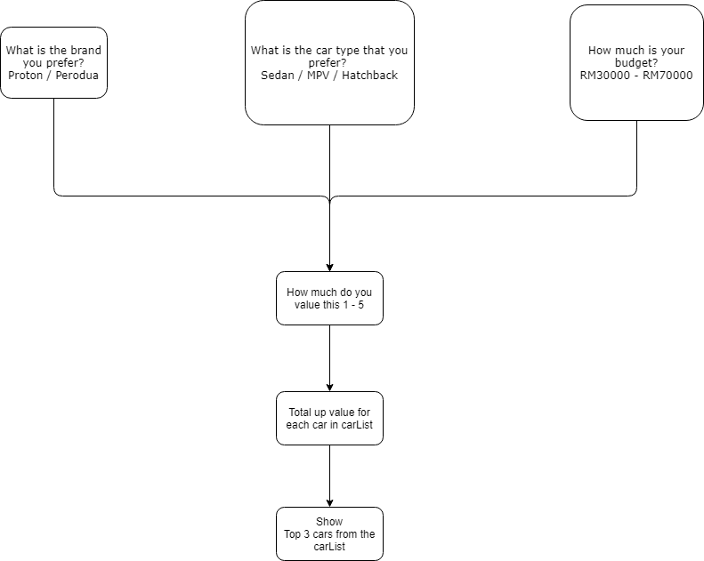

Slide 11
Algorithm and Technique
Relationship of the frame: AKO
e.g. Car (superclass) and Axia (subclass)
Procedural Informations (Demon): IF-NEEDED
e.g. Price
Iteration
to ensure inference engine keep running

Slide 12
DEMO

Slide 13
QnA Session

